Slide 1






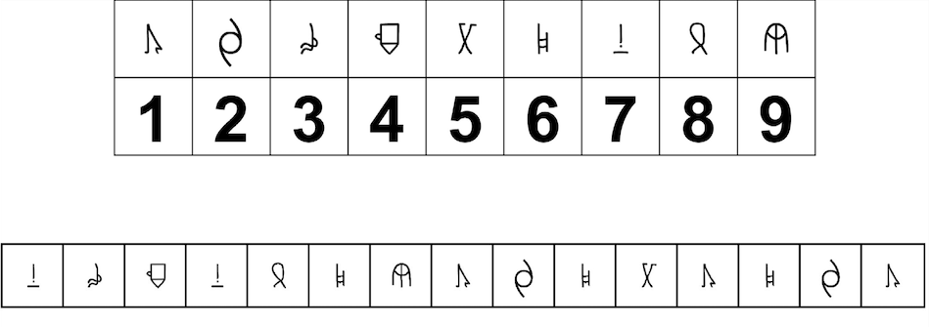
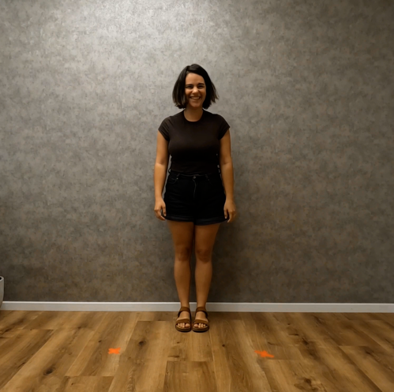

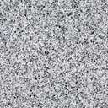
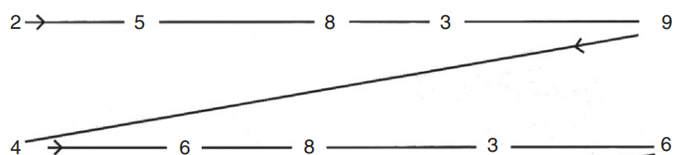
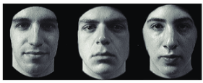
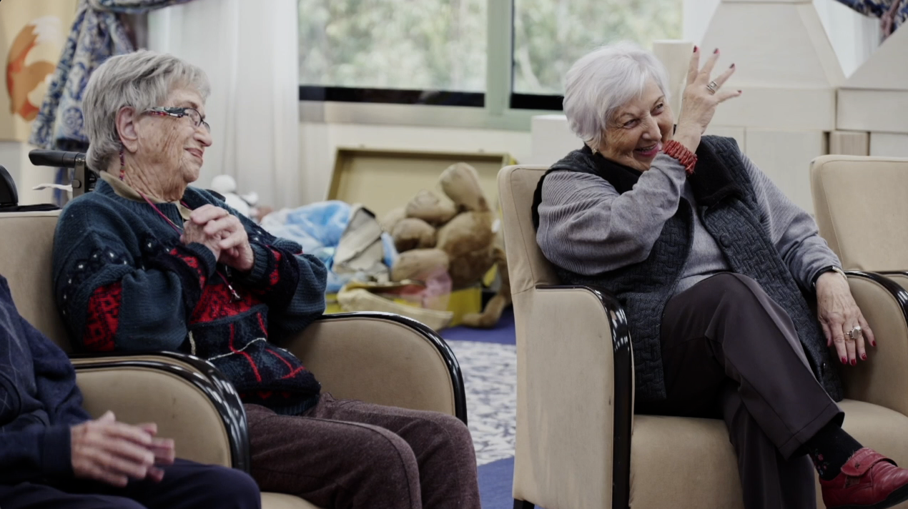
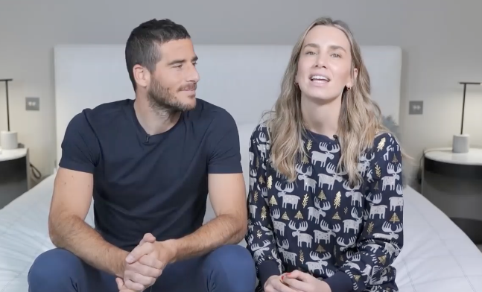
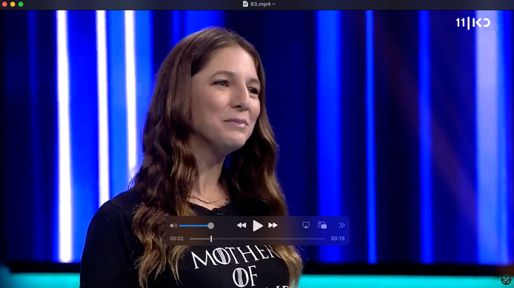
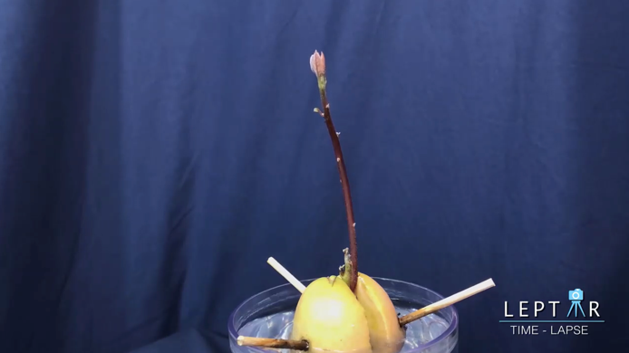
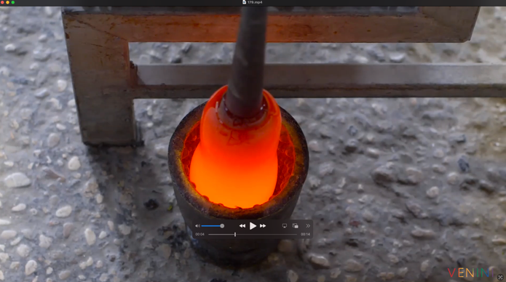
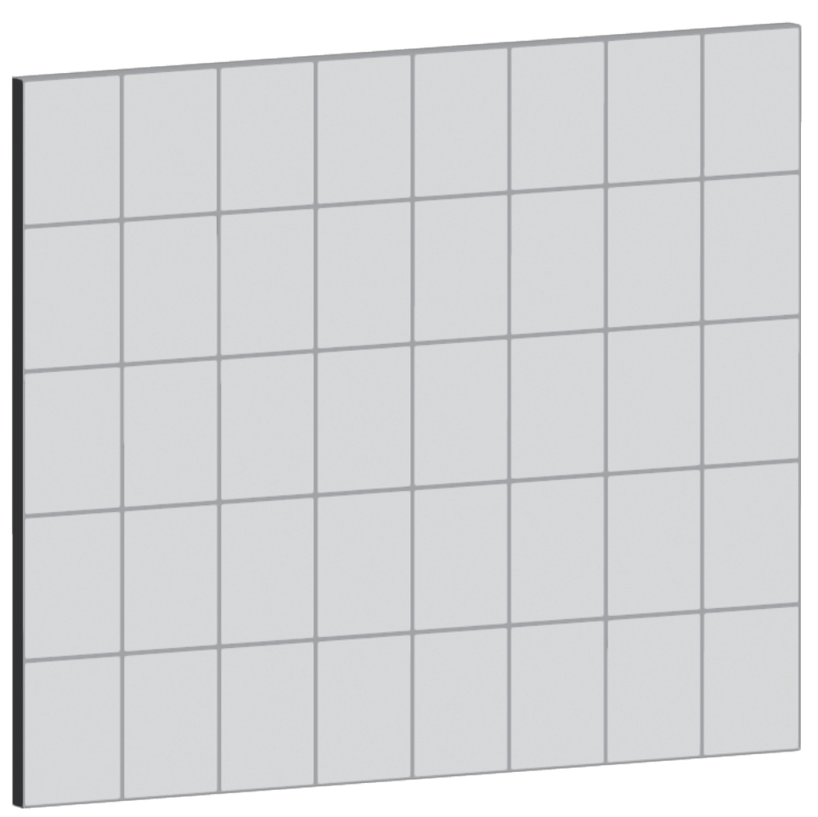
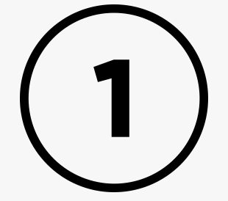
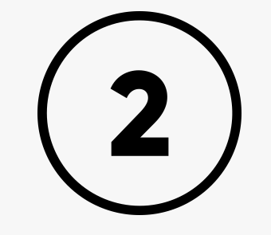
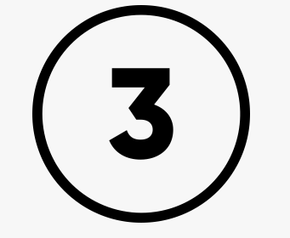
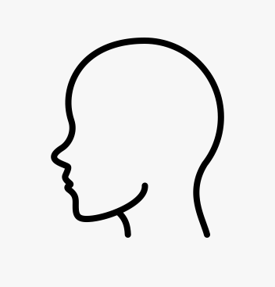
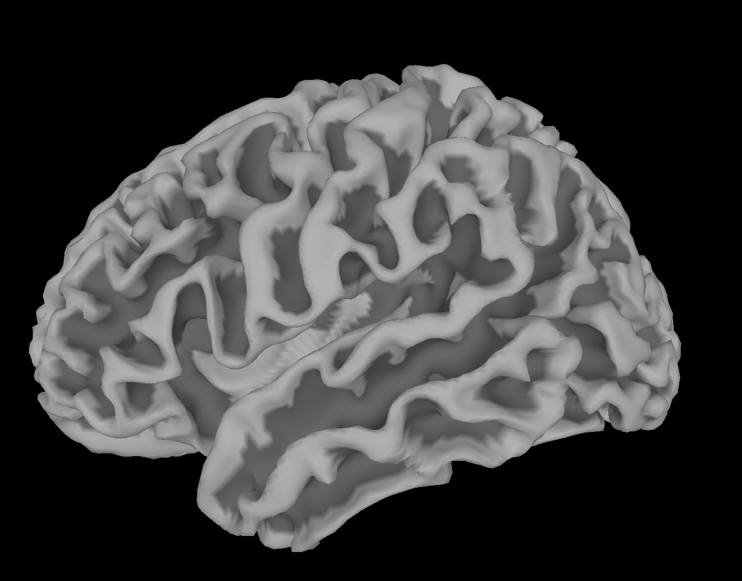
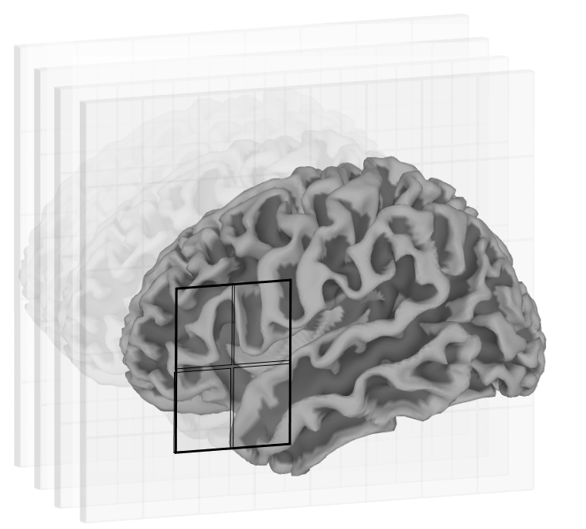
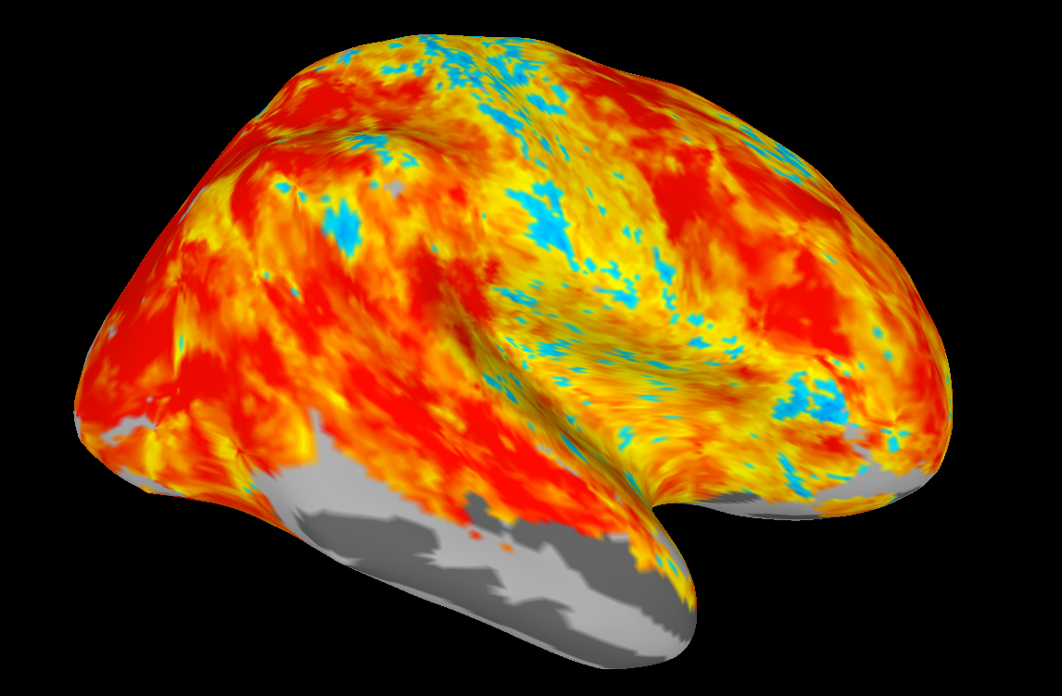
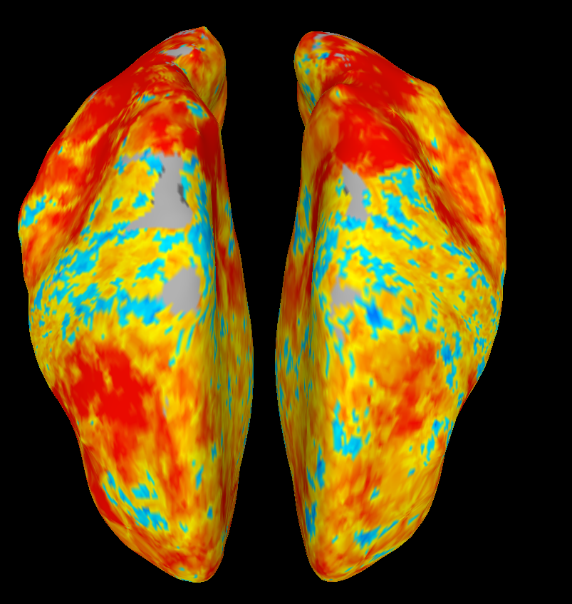
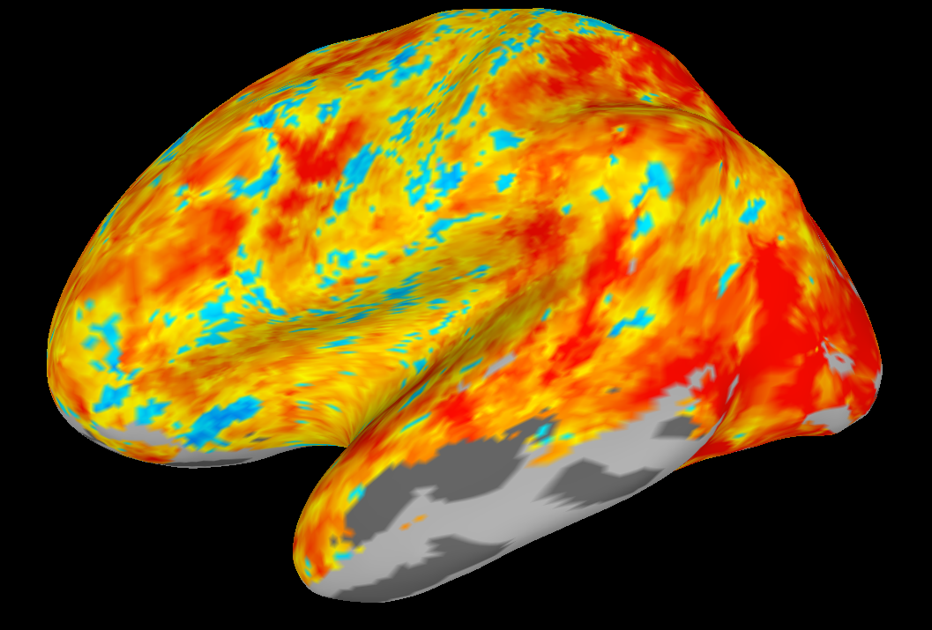
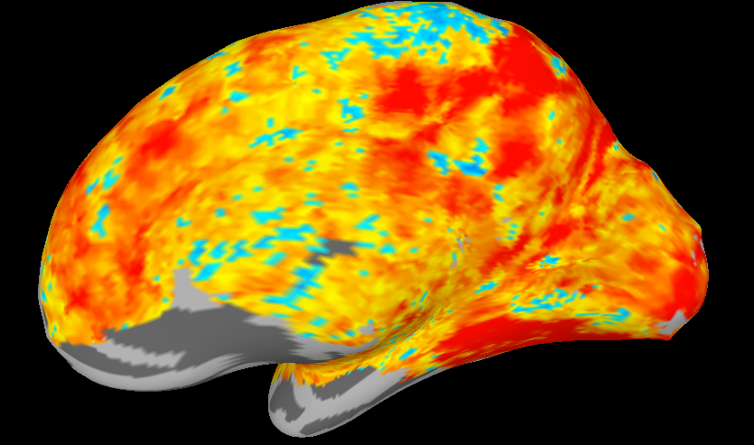
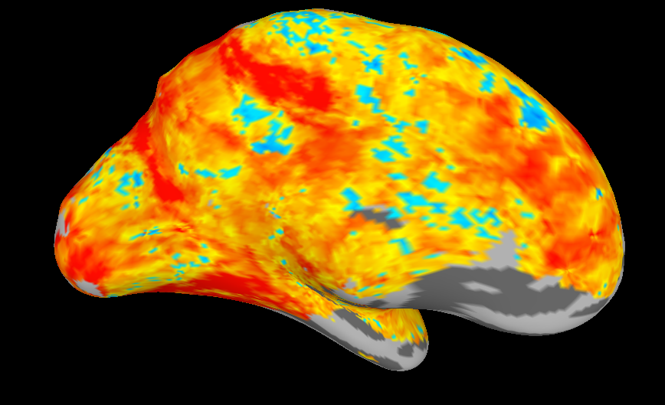
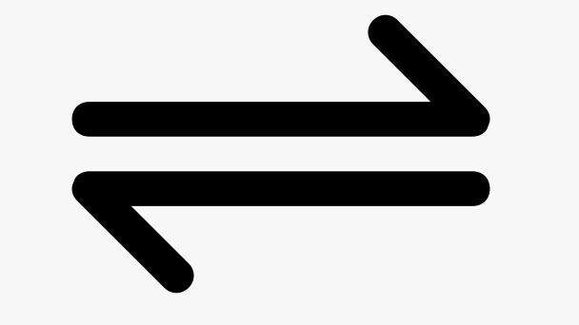


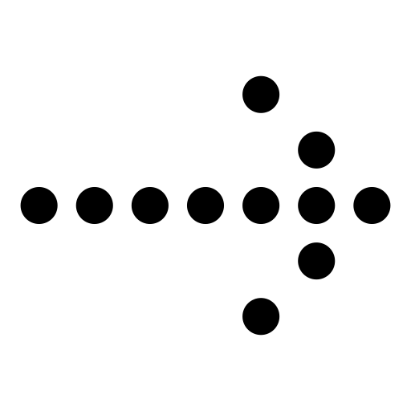
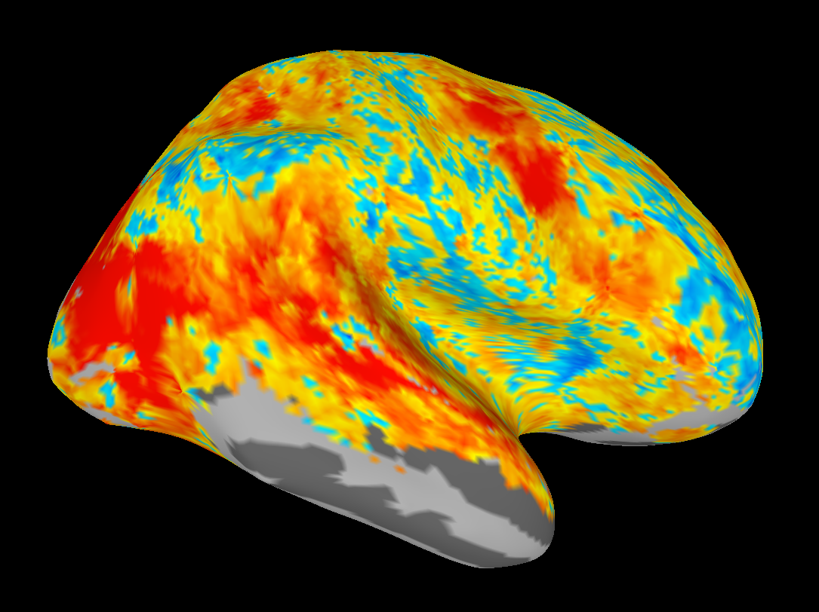
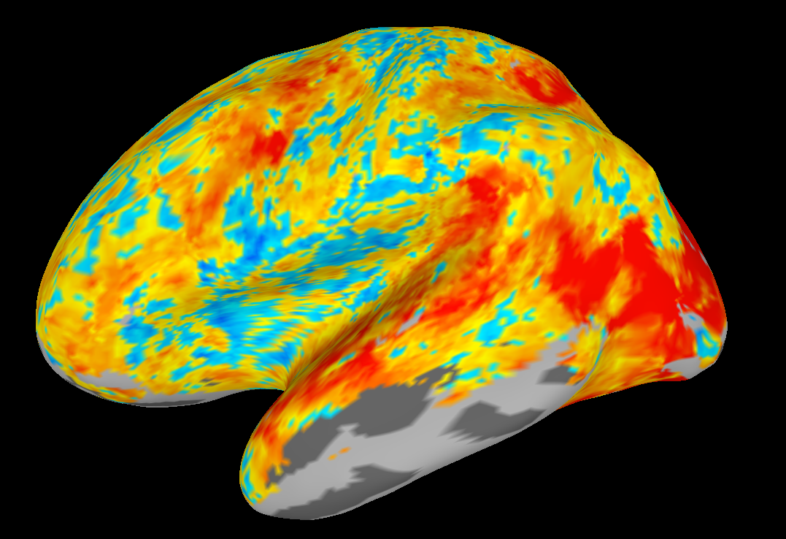
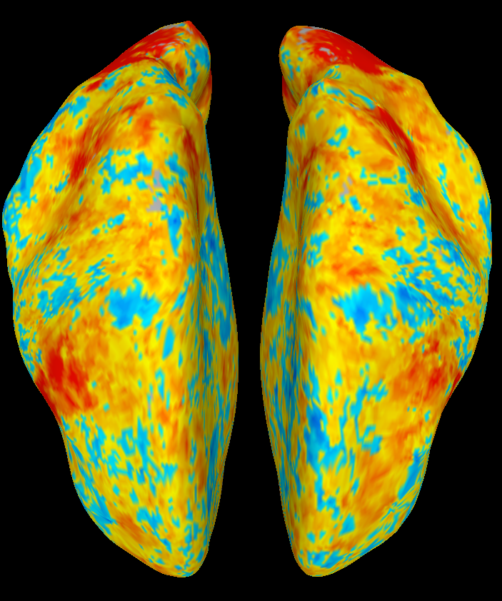
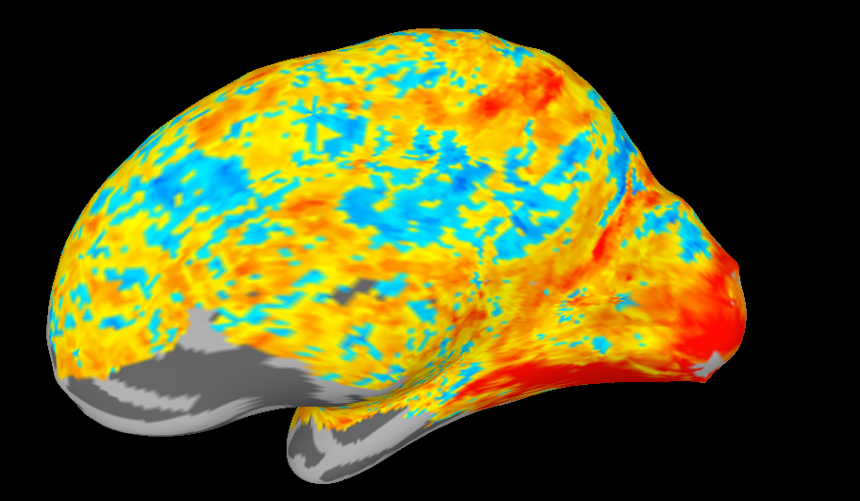
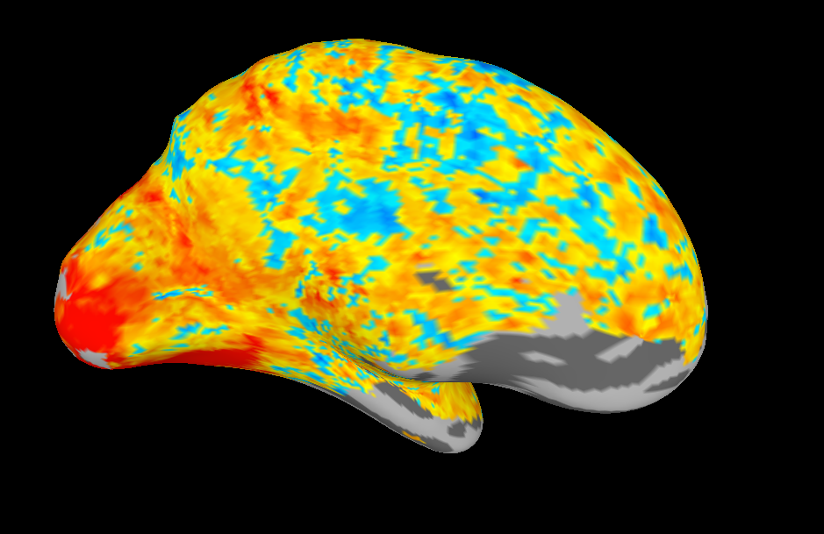
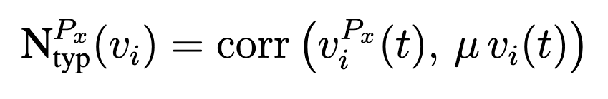
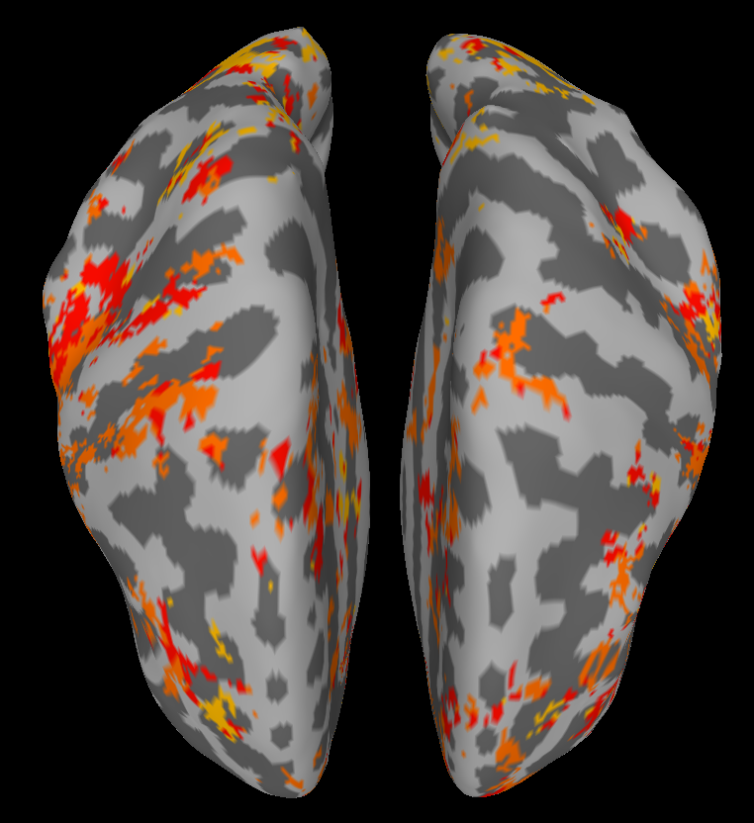
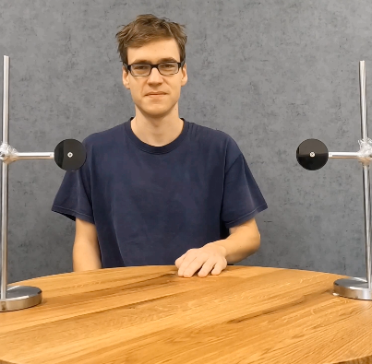
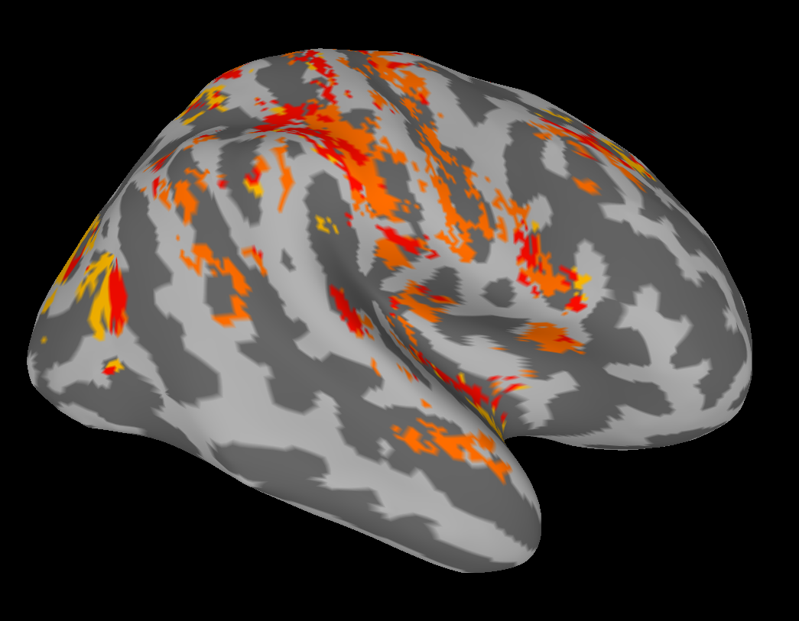
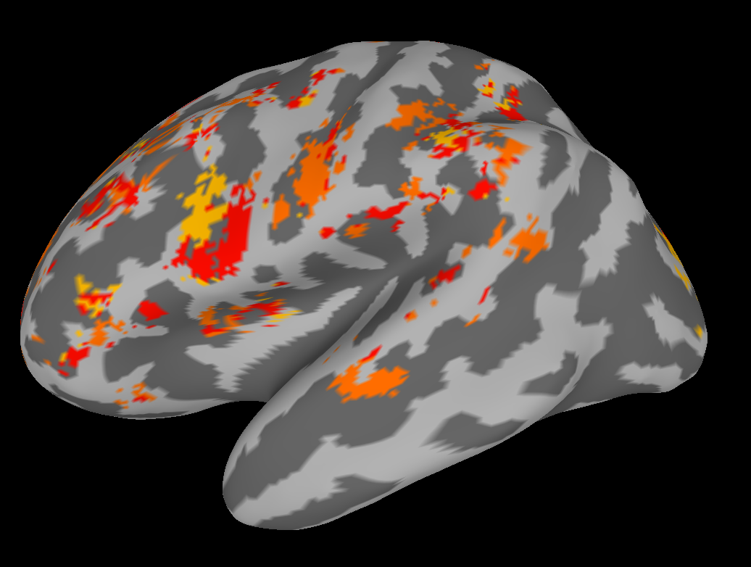
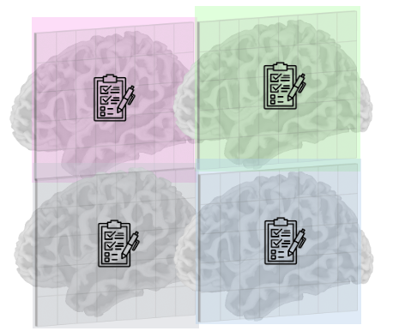
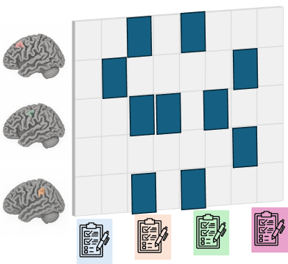

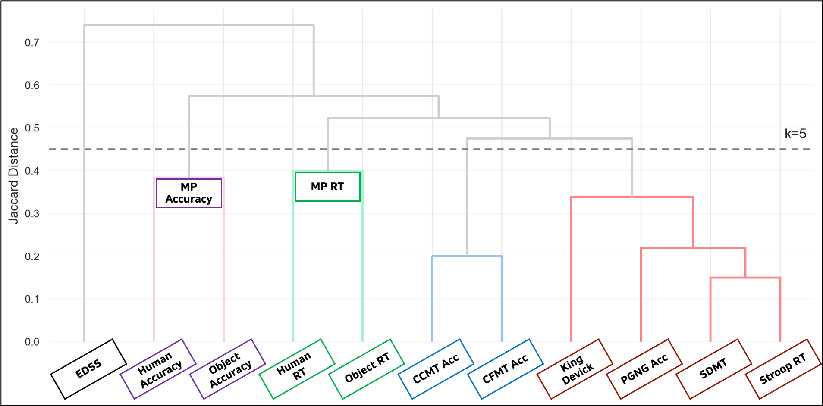
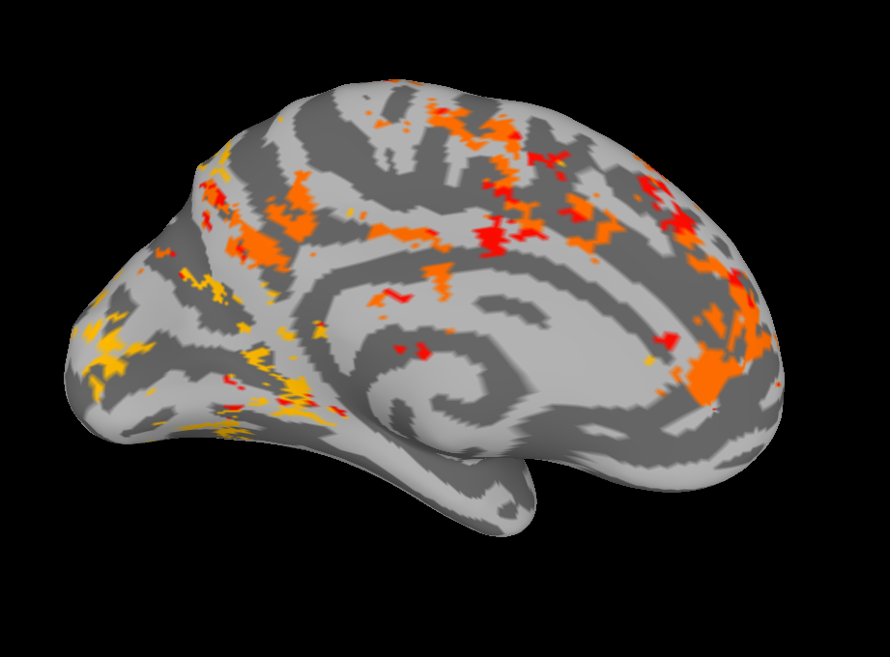
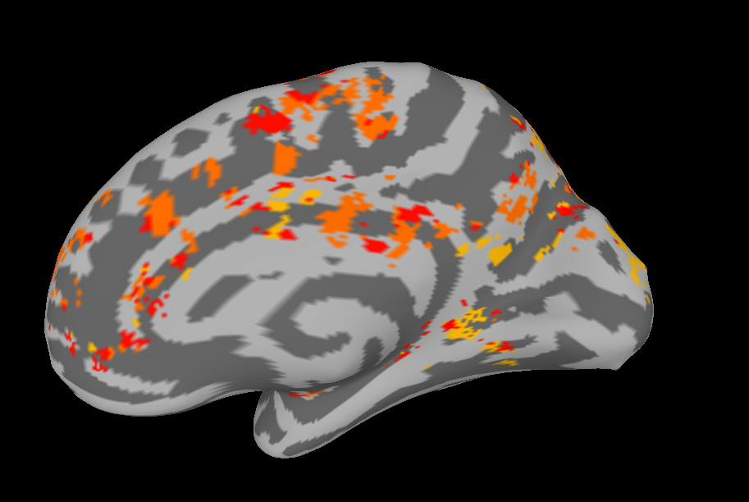
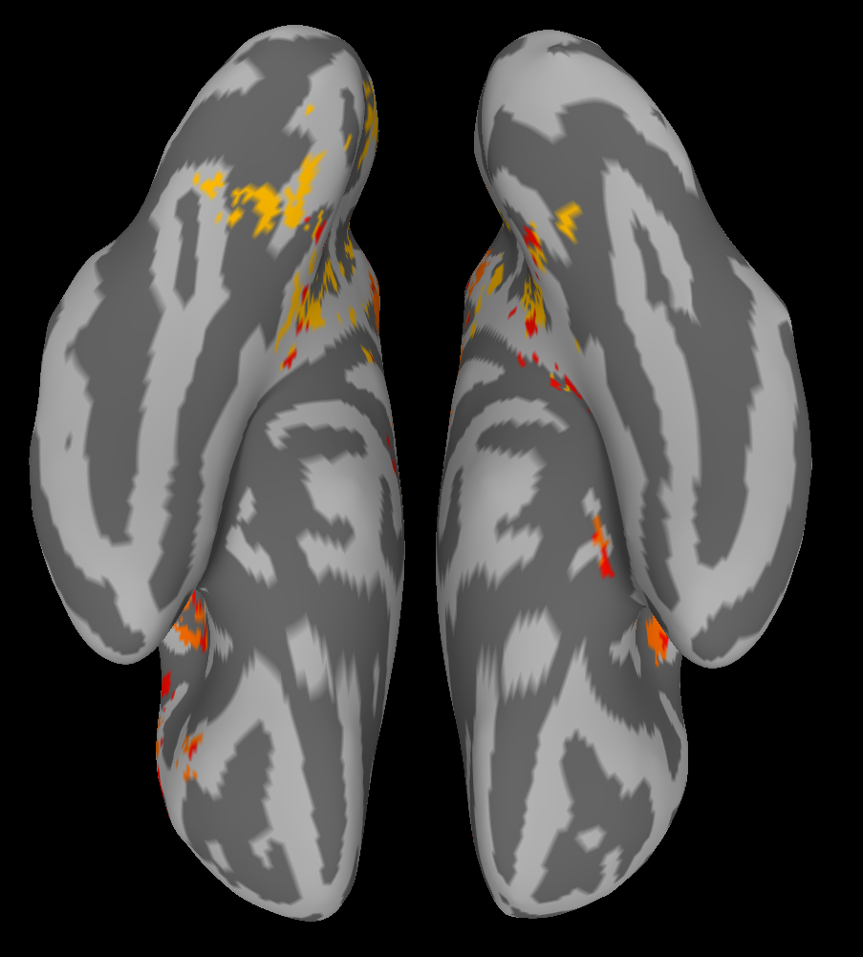
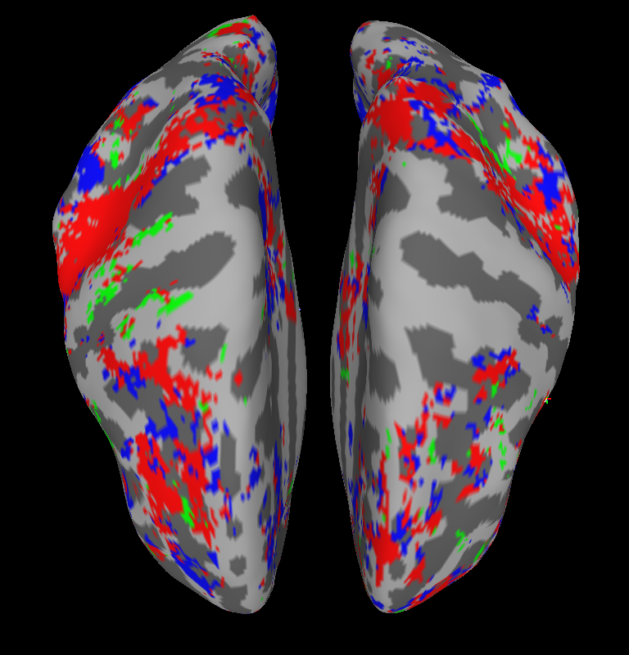

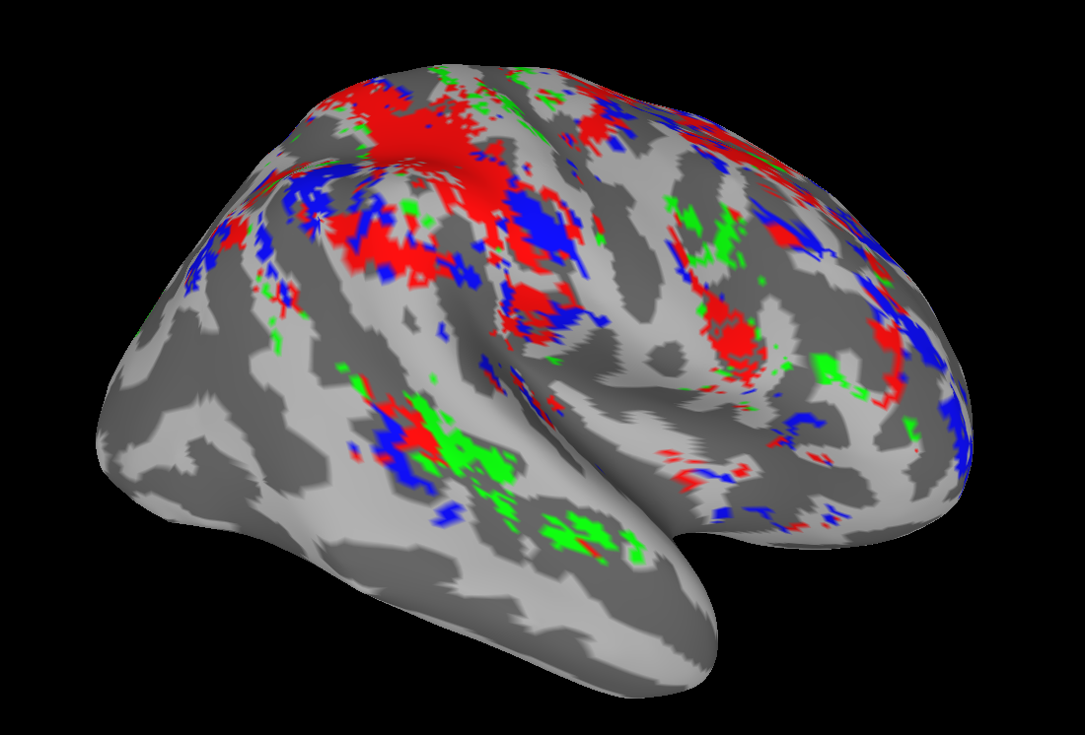
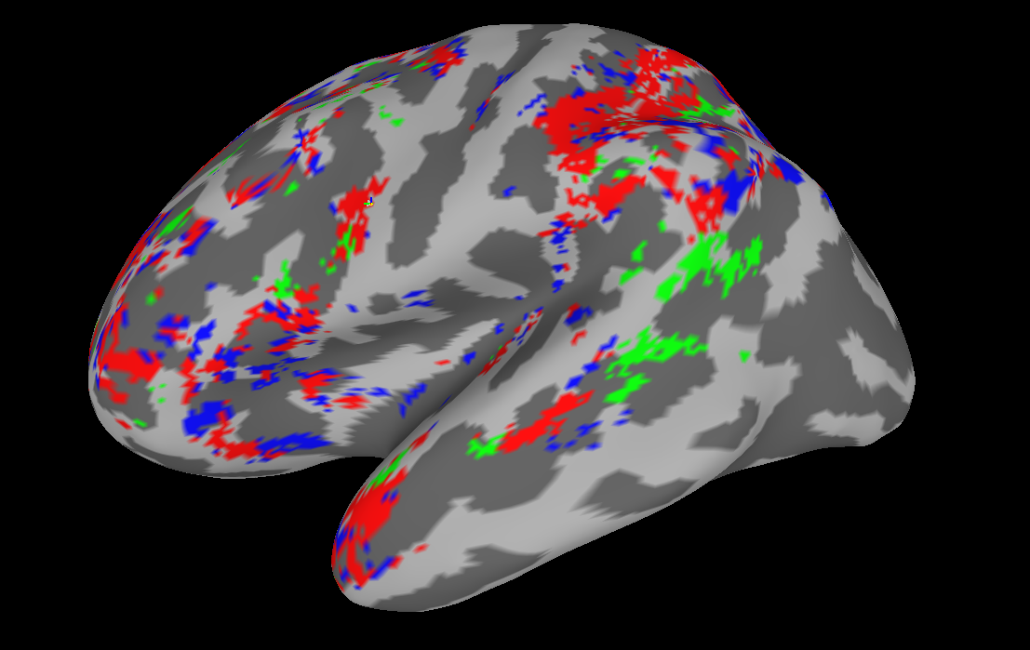



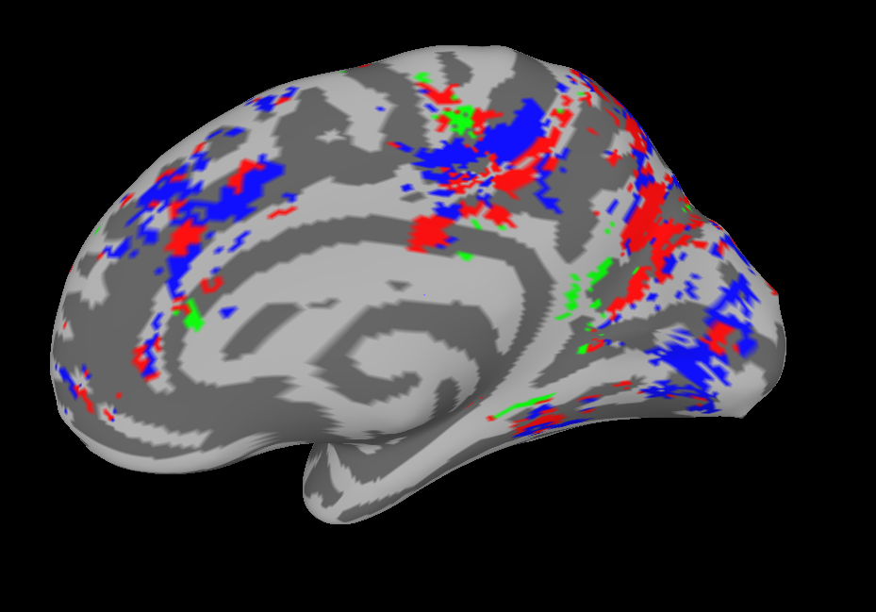
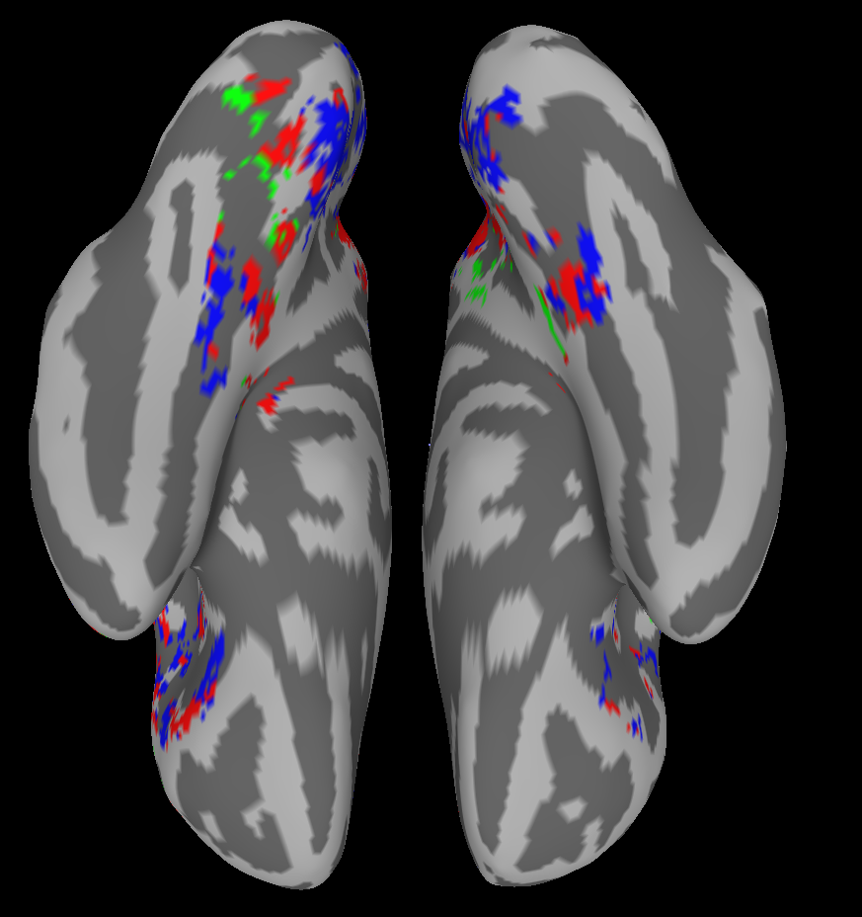
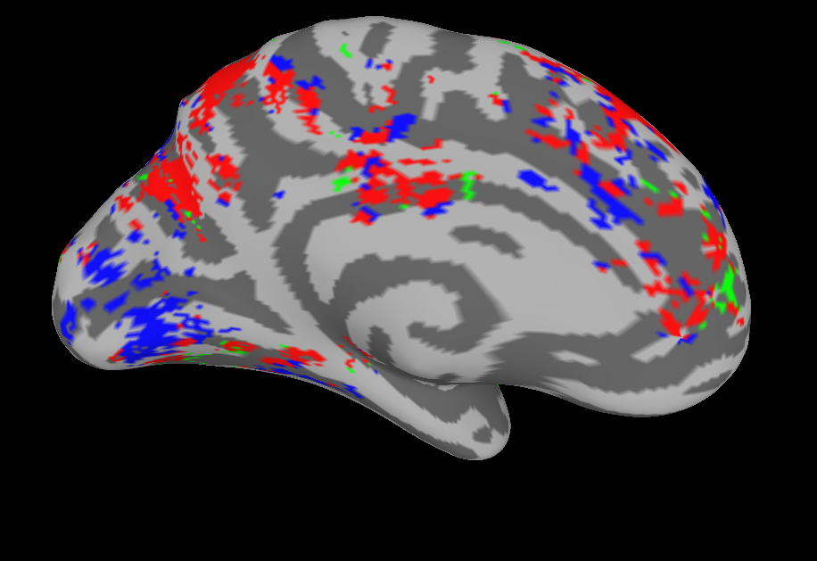
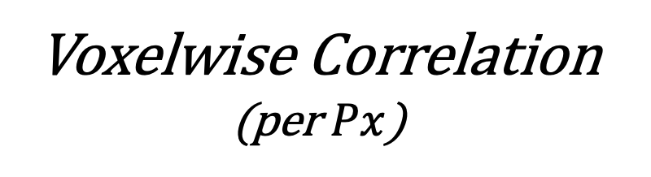
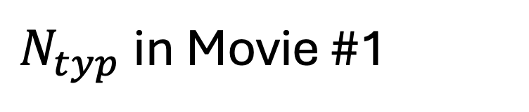
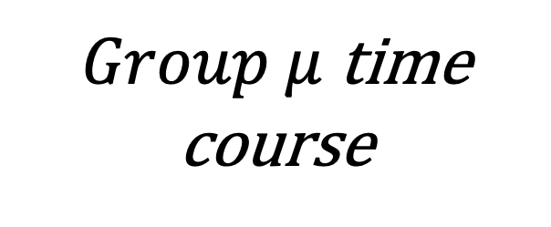
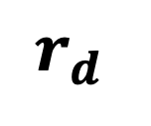


























Neural Typicality During Naturalistic 7T fMRI Tracks Cognitive Performance in Multiple Sclerosis
Ido Har Shalom¹, Aviv Jarbi¹, Michal Zamberg-Elad¹, Hadar Kolb², Michal Ramot¹
Department of Brain Sciences, Weizmann Institute of Science¹
Department of Neurology, Tel-Aviv Sourasky Medical Center²
$$μ$$
Key Takeaways
Experimental Design (Two full days of data collection per $Px$)
Neural Typicality ($N_{typ}$) during movie watching can serve as a brain based-marker predictive of cognitive performance
Multiple Sclerosis (MS) is associated with reduced $N_{typ}$, with patients showing more atypical neural responses than healthy controls
Regions with MS-related disruption in $N_{typ}$ overlap with those linked to behavior
Same regions, different dynamics: MS alters how the brain processes cognition
Extensive Behavioral Battery
2x fMRI Movies
Clinical/Demographics
EDSS (MS Only)
Age
For a given $Px$ and movie:
$N_{typ}$ is defined as the voxel-wise corr. with the mean time-course
N= 48 pwMS + 59 HC (max)
Neural Typicality $:$
Brain to Behavior
$$Px_{a}$$
F
$$r_{a}$$
$Group μ$ time course
Voxelwise Correlation
(per $Px$)
Individual $N_{typ}$
C
$$Px_{b}$$
$$r_{b}$$
$$n=107 \left(48 pwms\right)$$
$$Px_{a}$$
$$Px_{c}$$
A-
$$r_{c}$$
$$Px_{d}$$
A+
$$r_{d}$$
-0.5
$$r$$
0.5
$$Px_{e}$$
A
$$r_{e}$$
$$r_{(r)}$$
Neural Typicality $:$
$$Px_{b}$$
Voxelwise corr. between $N_{typ}$ and behavioral performance
Voxel-wise $N_{typ}$ to Behavior Corr.
Task Clustering by Neural Profiles
Human Movement Prediction Performance
$N_{typ}$in Movie #1
Threshold r=0.3
Clusters >200 voxels
MS
HC
Overlap (NN=1)
$N_{typ}$ Correlates to Task Performance
Voxels with MS-HC
$N_{typ}$ Differences
Voxels with
$N_{typ}$- Behavior Correlations
Overlap
Regions that differentiate MS and HC individuals based on $N_{typ}$
during Movie #2
Regions where $N_{typ}$during Movie #1 correlates with task performance
MS-related differences overlap with those predictive of cognitive performance
Ido.Har-Shalom@weizmann.ac.il

